Slide 1
Visual storytelling on the web
Data Studio – Lede Program
Ashlyn Still
@ashlynstill
as5962@columbia.edu

Slide 2
Before we get started….
grab a partner!

Slide 4
How did it go?
What types of instructions were the most helpful? What about the least helpful?

Slide 5
Why does web design matter in data reporting and visualization?

Slide 6
Why does web design matter in data visualization?
The best data-driven stories are more than just text alone, analysis alone, visualization alone. It’s about the whole package.

Slide 7
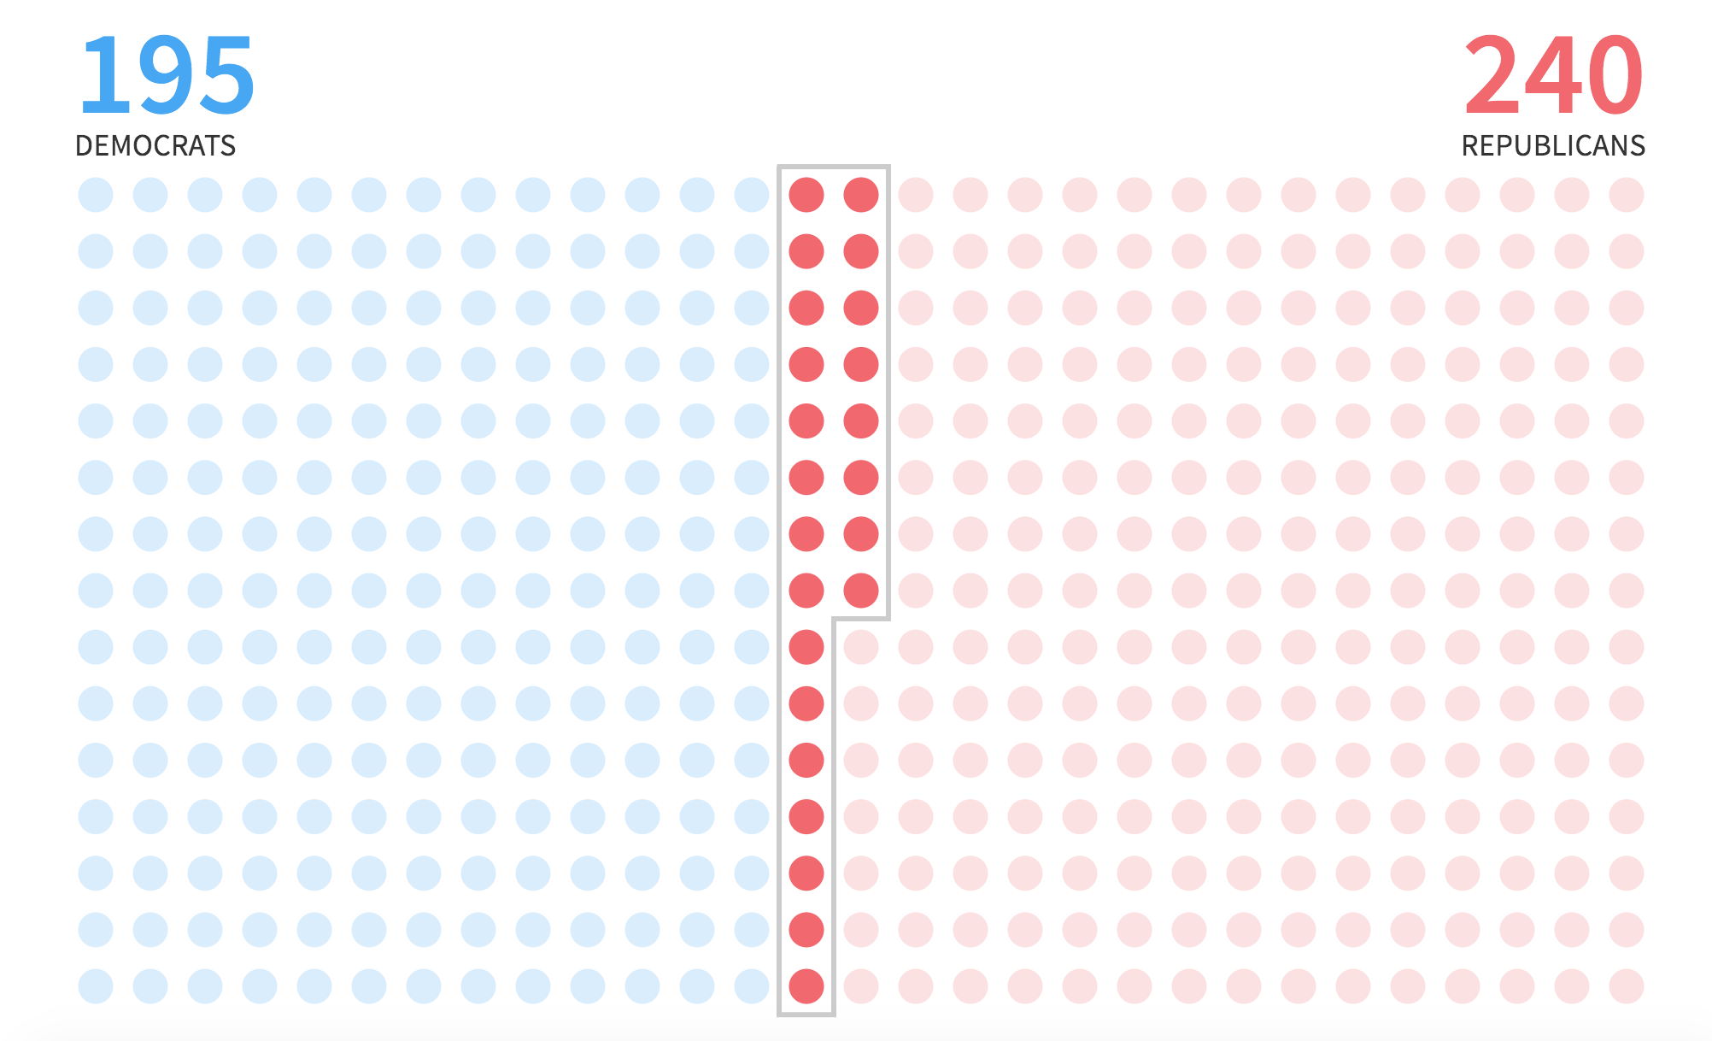
Notes:
https://graphics.reuters.com/USA-ELECTION-BLUEWAVE/010080J912P/index.htm

Slide 8
Why does web design matter in data visualization?
The best data-driven stories are more than just text alone, analysis alone, visualization alone. It’s about the whole package.
Digital design literacy isn’t a “nice to have” skill in newsrooms anymore. It’s a necessary skill.

Slide 9
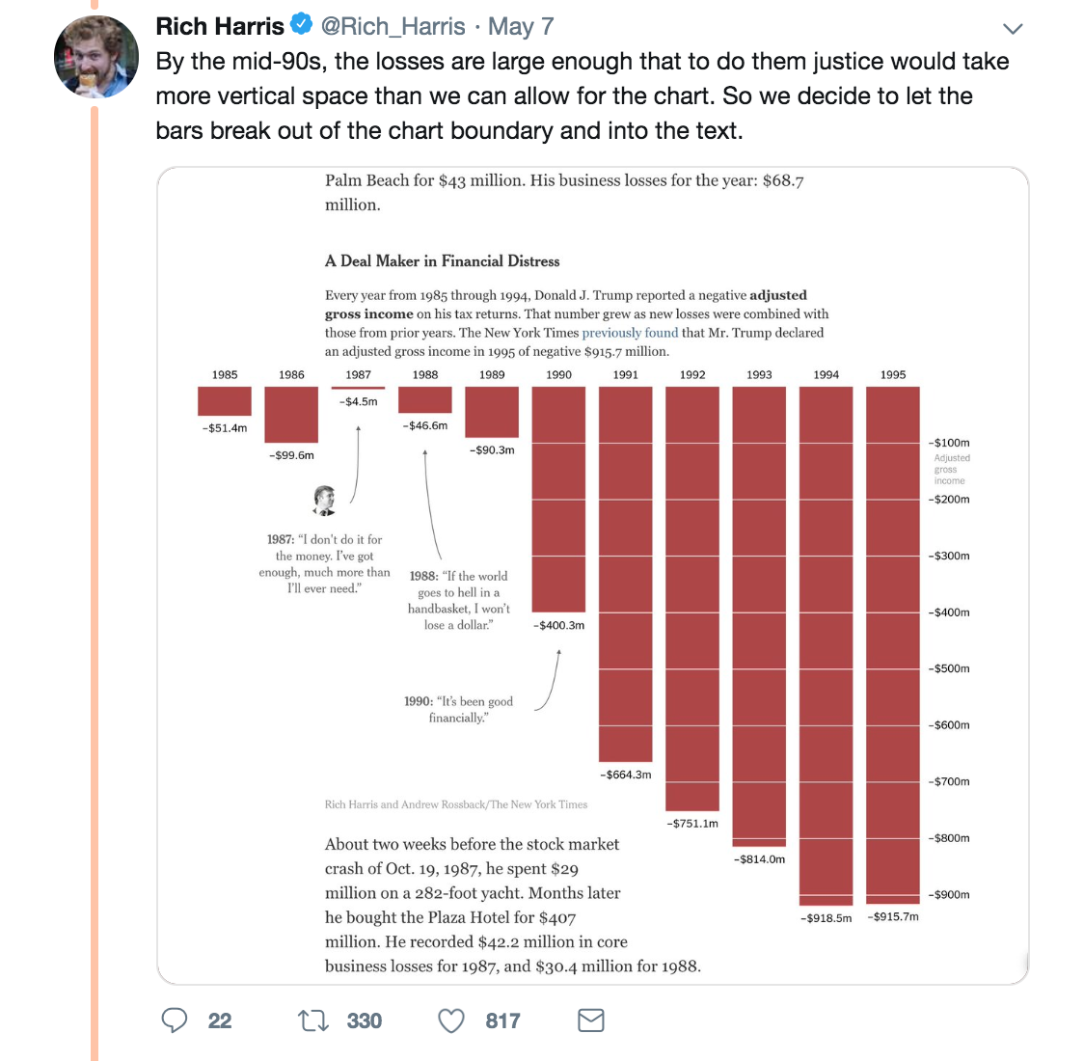
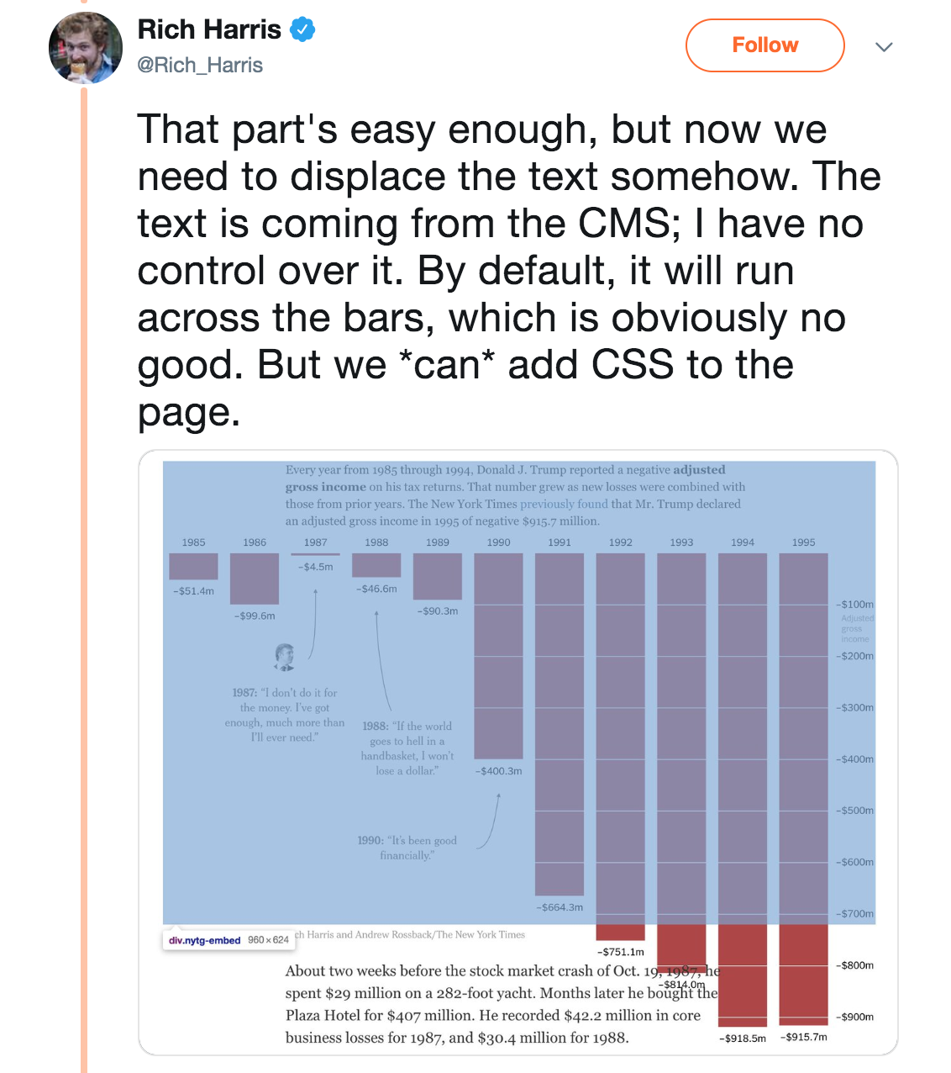
Notes:
https://www.nytimes.com/interactive/2019/05/07/us/politics/donald-trump-taxes.html
https://twitter.com/Rich_Harris/status/1125924852047712256

Slide 10
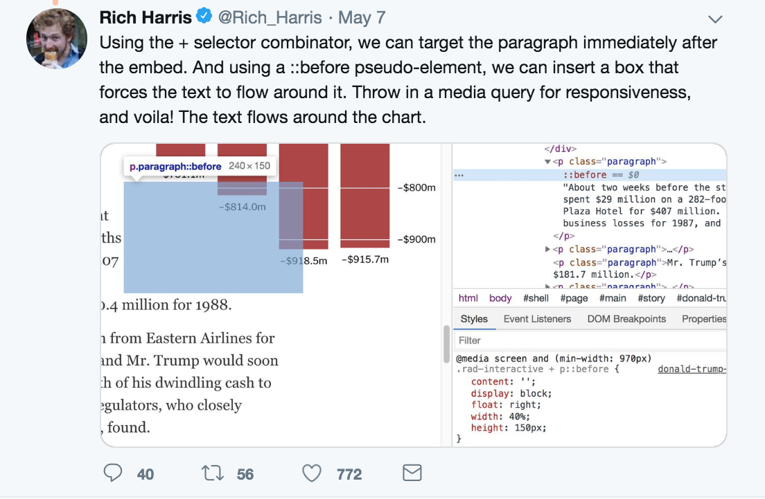

Slide 11
Why does web design matter in data visualization?
The best data-driven stories are more than just text alone, analysis alone, visualization alone. It’s about the whole package.
Digital design literacy isn’t a “nice to have” skill in newsrooms anymore. It’s a necessary skill.
When a chart shouldn’t be a chart: Some data stories are best told with layout + design

Slide 12

Notes:
https://www.nytimes.com/interactive/2016/02/26/us/race-of-american-power.html

Slide 13
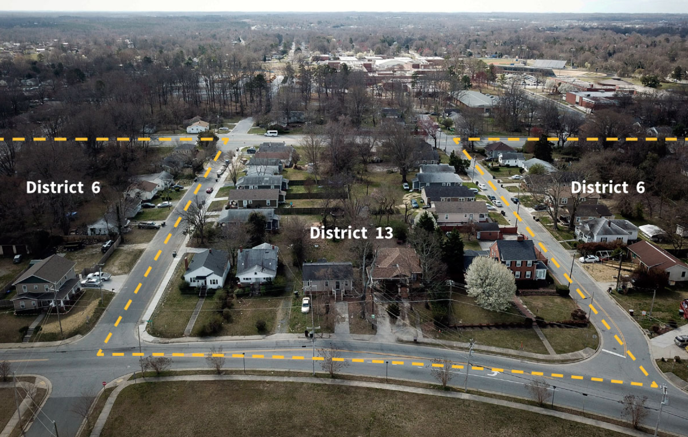
Notes:
https://graphics.reuters.com/USA-COURT-GERRYMANDERING/010091701PF/index.html

Slide 14
Why does web design matter in data visualization?
The best data-driven stories are more than just text alone, analysis alone, visualization alone. It’s about the whole package.
Digital design literacy isn’t a “nice to have” skill in newsrooms anymore. It’s a necessary skill.
When a chart shouldn’t be a chart: Some data stories are best told with layout + design
News design isn’t about making stories look “nice” or “pretty”. It’s about using visual cues and design elements to tell stories and explain complex ideas.

Slide 15
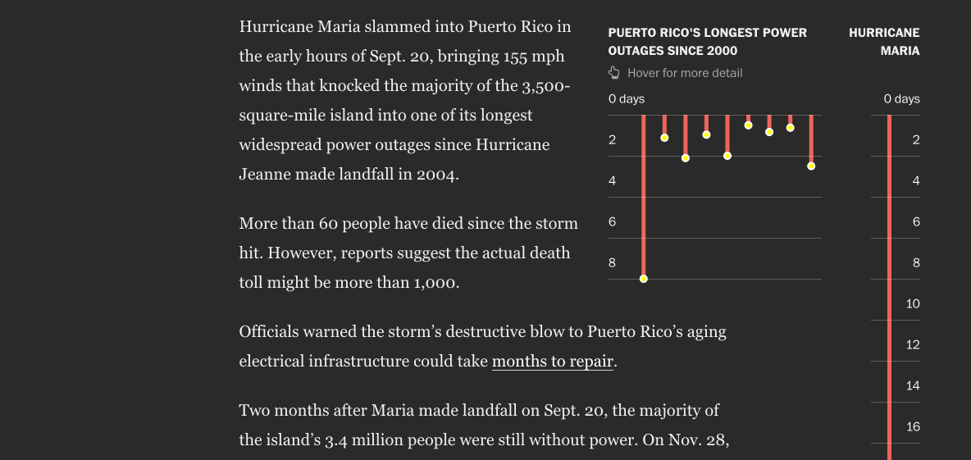
Notes:
https://www.washingtonpost.com/graphics/2017/national/puerto-rico-hurricane-recovery/?utm_term=.d83803199e9a

Slide 16

Notes:
https://graphics.reuters.com/INDIA-ELECTION-CRIMINAL-CANDIDATES/0100925031T/index.html

Slide 17
HTML + CSS =
Building blocks of the web

Slide 18
What is HTML?
HTML isn’t a programming language – it’s a markup language that tells the browser how to structure web pages
It’s made up of elements, which you use to enclose, wrap, or mark up different parts of the content to make it appear or act a certain way

Slide 19
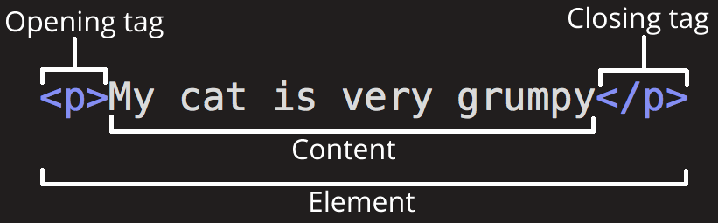
The anatomy of an HTML element

Slide 20
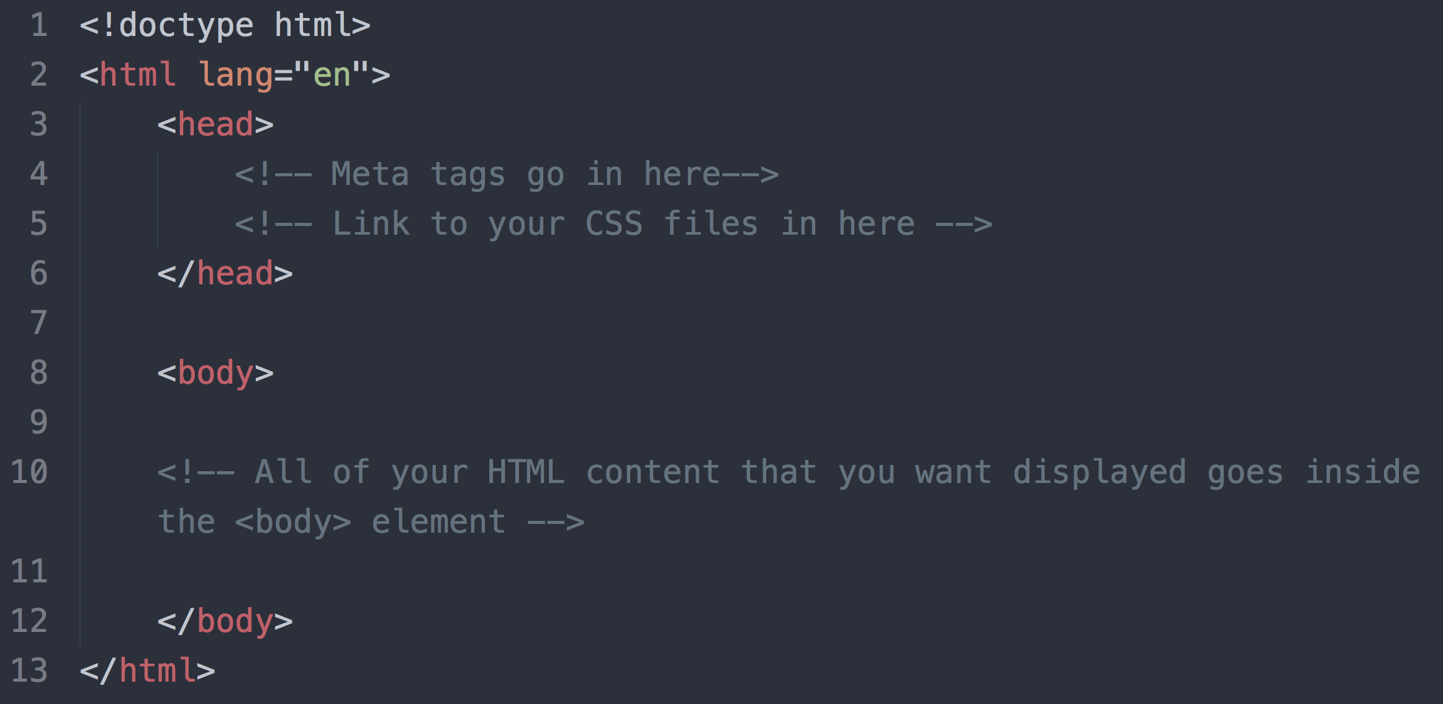
Notes:
Basic page structure without content
HTML element
<head> and metadata
Linking to your CSS (and eventually, js files)
Body tag
Most important rule: ALWAYS CLOSE YOUR ELEMENTS.

Slide 21
Types of elements: Block elements
Block elements give the page structure
They appear on the screen as if they have a line break before and after them
Some examples of block elements: <p>, <h1>, <h2>, <h3>, <h4>, <h5>, <h6>, <ul>, <ol>, <dl>, <pre>, <hr />, <blockquote>, and the most important: <div>

Slide 22
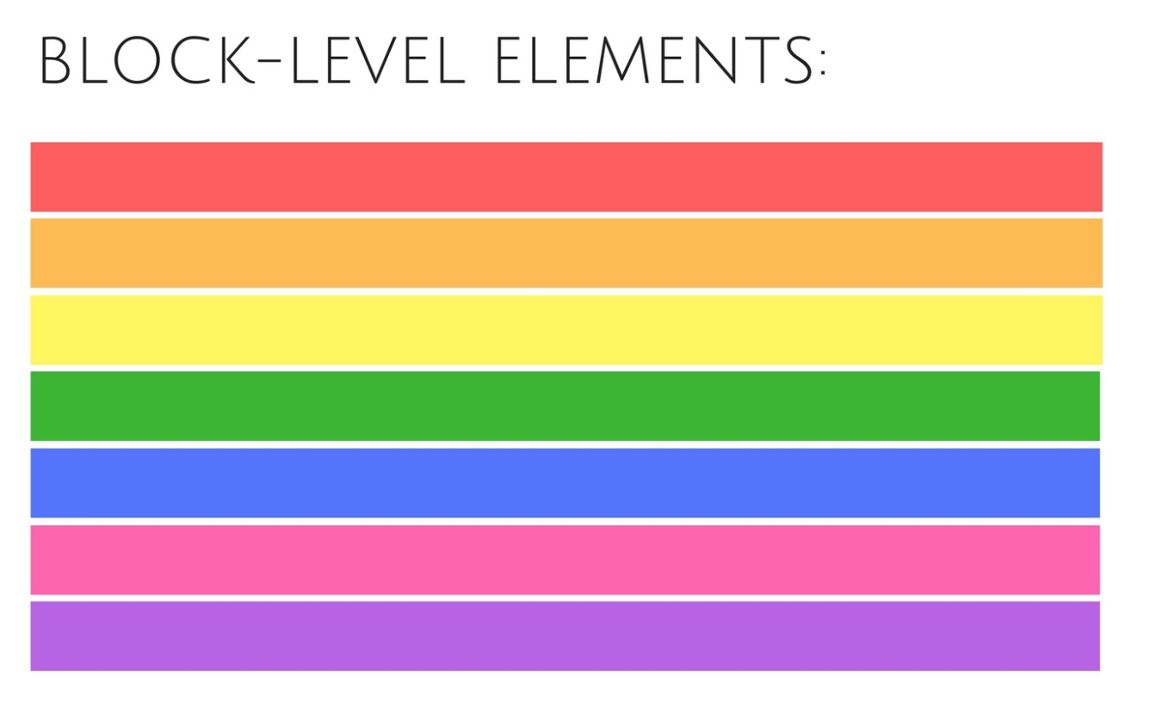

Slide 23
Heading and paragraph elements
Heading tags are important because search engines use them to index the content of your pages
Heading tags include: <h1>, <h2>, <h3>, <h4>, <h5> and <h6> with h1 being read as the most important and h6 being read as the least important
All other body text goes inside paragraph elements <p>
HTML provides default styles for these but you can change them with CSS as well
Notes:
https://www.w3schools.com/html/html_headings.asp

Slide 24
Breaking things up
Horizontal rules and line breaks are often used in HTML to add spacing and break things up.
They are self contained and don’t need to be closed because they include a closing slash within the element itself
<hr/> creates a horizontal rule and defines a thematic break in an HTML page
<br/> adds a line break
Notes:
https://www.w3schools.com/html/html_headings.asp

Slide 25
<div> aka your HTML organization BFF
<div> elements are arguably the most used HTML element
<div> = “division”
DIV elements can be used to structure HTML documents as a hierarchy of divisions
When combined with CSS, <div> elements are what control the layout and structure of an HTML page

Slide 26
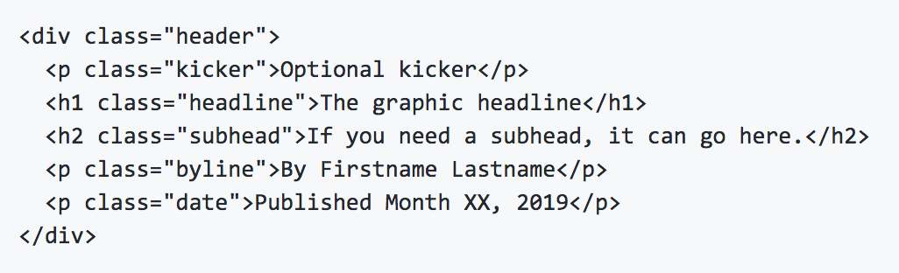
An example from our project template
This div wraps around a series of block elements to create a section of a page

Slide 27
Types of elements: Inline elements
Inline elements almost always live nested within block elements
They do not have to appear on a new line of their own
The <a>, <b>, <i>, <u>, <em>, <strong>, <sup>, <sub>, <big>, <small>, <li>, <ins>, <del>, <code>, <cite>, <dfn>, <kbd>, and <var> elements are all inline elements.
They are often used to style sections of text within paragraphs
<span> tags are like the inline version of <div> – they help group inline items, or add specific CSS styles to inline content.

Slide 28


Slide 29
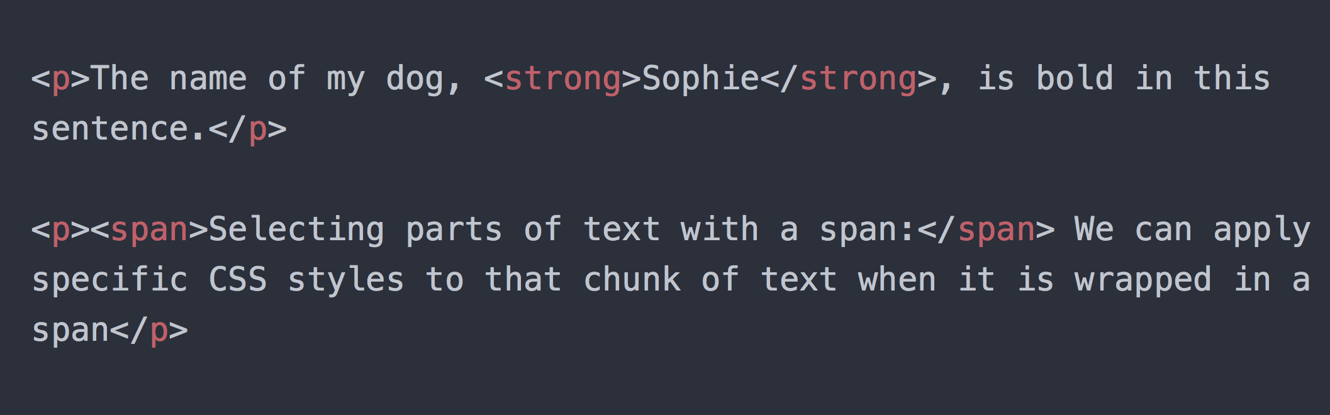
Inline elements in action

Slide 30
What about CSS?
CSS stands for Cascading Style Sheets because the computer reads it top to bottom and inherits the most recent reference OR the most specific reference to a selector.
HTML was never intended to describe how a web page looks, its only intention is to describe the content of a web page.
CSS describes how the HTML content should function on the page
You attach CSS to your HTML elements via CSS selectors referencing tags, classes, and ids on your HTML elements.

Slide 31
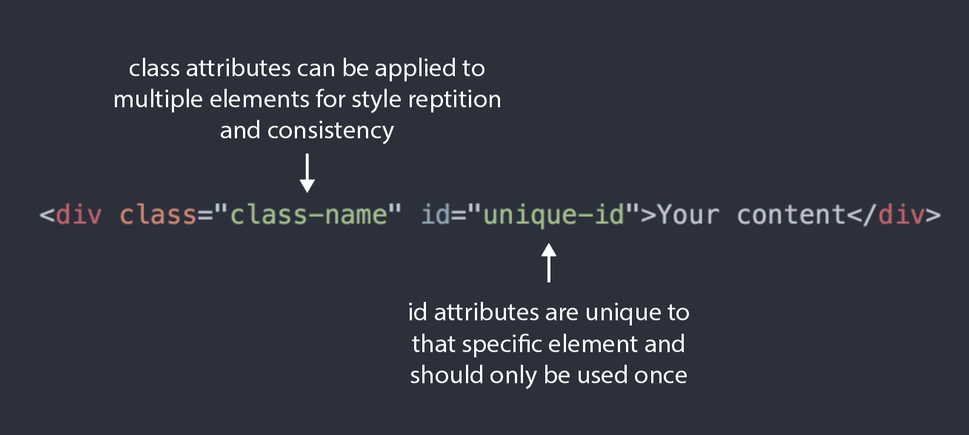

Slide 32
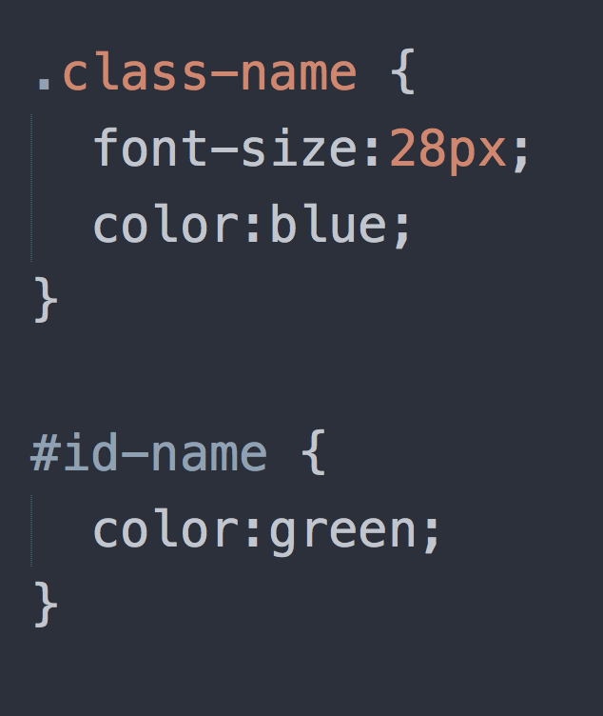
Class selectors in CSS are referenced with a period
ID selectors in CSS are referenced with a hash (#)
Notes:
If these are the styles for the previous div, what color do you think the content will be?

Slide 33
Putting it all together on a page
The number one rule is to ALWAYS CLOSE YOUR HTML ELEMENTS
I.E. If you have a <div>, there has to be a corresponding </div>
Don’t be afraid to nest your elements
Often, the best way to organize your content is to put divs inside of other divs (inside of other divs!)
But make sure that your inline elements are always inside a block element – block elements rarely should be inside inline elements
Google is your pal
When in doubt, take a look at W3Schools and the Mozilla HTML + CSS guides
Notes:
https://developer.mozilla.org/en-US/docs/Learn/HTML/Introduction_to_HTML
https://developer.mozilla.org/en-US/docs/Learn/HTML/Introduction_to_HTML/Debugging_HTML
https://developer.mozilla.org/en-US/docs/Web/CSS

Slide 34
Let’s practice in small groups

Slide 35
Instructions:
Using pseudo code, draft out on paper how you might structure an HTML page for a digital version of one of the following:
A restaurant menu
A resume
A letter
Don’t be afraid to get creative with text styles (like using different heading elements) and inline style elements (italics, bold, underline, etc). You can also use things like horizontal rules <hr/> to break things up
Notes:
https://developer.mozilla.org/en-US/docs/Learn/HTML/Introduction_to_HTML
https://developer.mozilla.org/en-US/docs/Learn/HTML/Introduction_to_HTML/Debugging_HTML
https://developer.mozilla.org/en-US/docs/Web/CSS

Slide 36
Data studio HTML project template
https://github.com/hilaryfung/data-studio-2019
Notes:
https://github.com/hilaryfung/data-studio-2019

Slide 37
Homework
If you haven’t filled out the google form Hilary assigned on Monday, please fill it out before the next class!
Start outlining your first project in the project template. Next week we’ll start project critiques.
Be ready to share where you’re at with your projects before each class – we will call on students randomly for critique so come to class prepared!

